Slide 1
Protozoa
Superclass:Sporozoa(Apicomplexa)

Slide 2
General characteristics of Sporozoa
All of the species belong to this group are parasitic
Produce spores, Oocyst (A thick walled structure that contains the zygote of an apicomplexan parasite and release the infective sporozoites).
No clear organs for movement or locomotion.
Reproduction:
Asexual: Binary fission, Multiple fission.
Sexual: Anisogametes, Isogametes

Slide 3
Sexual Reproduction
(differentiation of zygote)
♀gametes
♂gametes
Zygote
Ookinate
Oocyst
sporocyst
spores

Slide 4
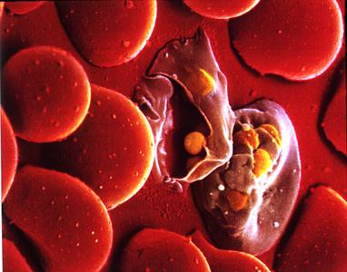
Malaria
Malaria is a mosquito-borne infectious disease of humans caused by eukaryotic protists of the genus Plasmodium

Slide 5
It is widespread in tropical and subtropical regions, including much of Africa, Asia and the Americas.
The disease results from multiplication of malaria parasites within red blood cells, causing symptoms typically include fever and headache, in severe cases progressing to coma, and death

Slide 6
Four species of Plasmodium can infect humans
Plasmodium falciparum
Plasmodium vivax
Plasmodium ovale
Plasmodium malariae

Slide 7
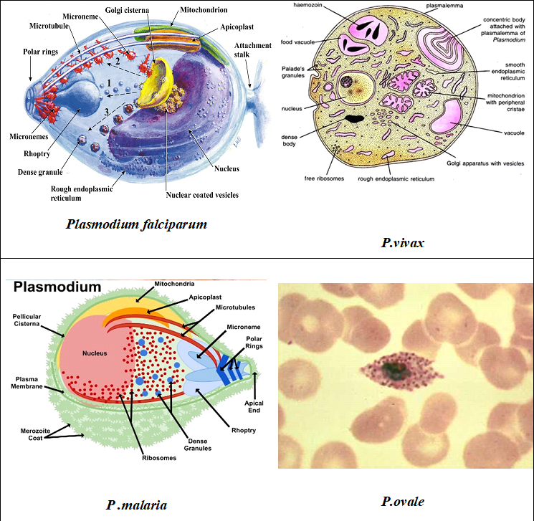

Slide 8
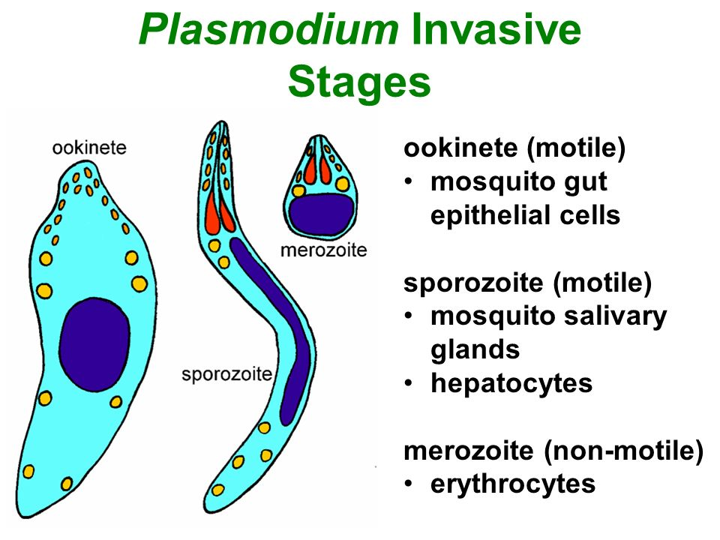

Slide 9
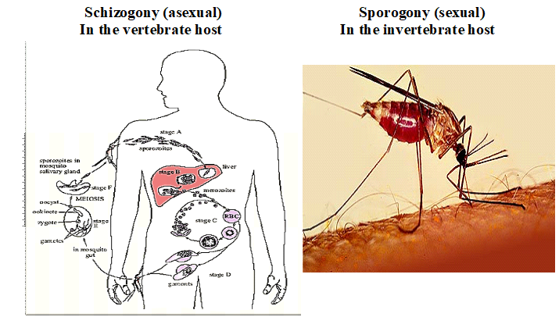
Plasmodium sp. Have two replication cycle

Slide 10
Sporogony(sexual)
The sexual stage in the life cycle of asporozoan parasite, with development of the zygote into one or several haploid spores, each containing a distinctive number of sporozoites
chizogony (asexual):
The multiple fission of a schizont into merozoites
Schizont : is a malaria parasite which has matured and contains many merozoites, which are the parasite stage that infects red blood cells

Slide 11
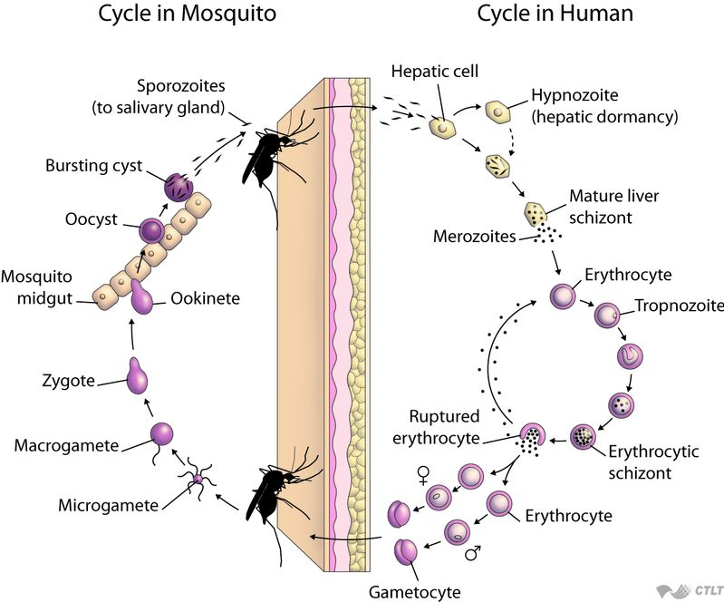

Slide 12
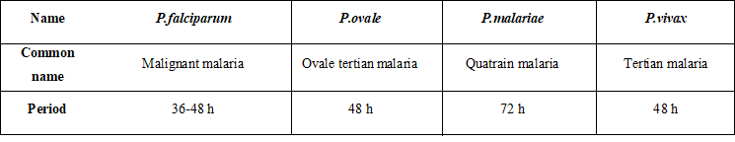
Life cycle of Plasmodium in mammals (asexual)

Slide 13
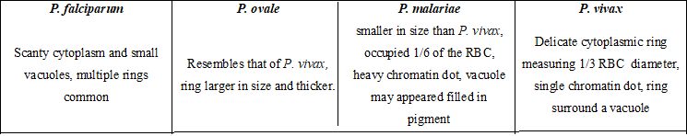
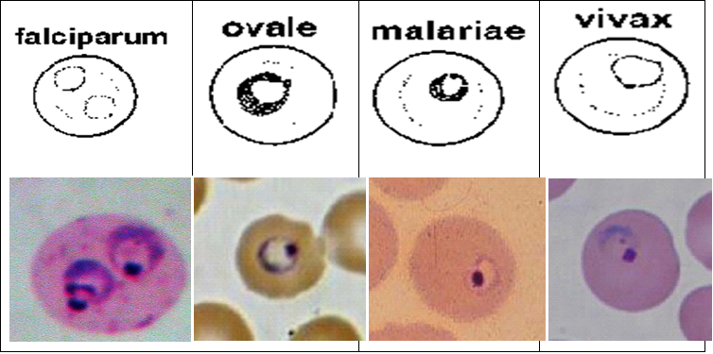
Ring form (early trophozoites)

Slide 14
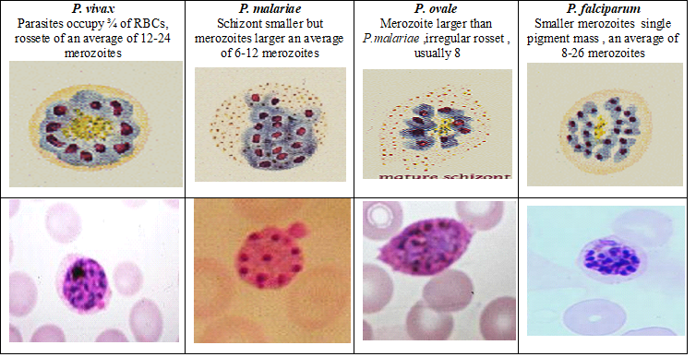
Mature Schizont (Characteristics)

Slide 15
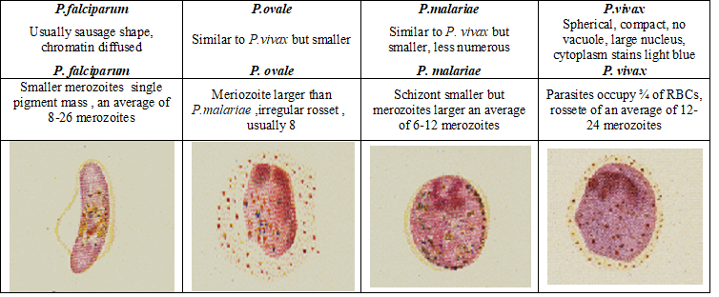
Microgametocyte (Characteristics)

